Slide 1



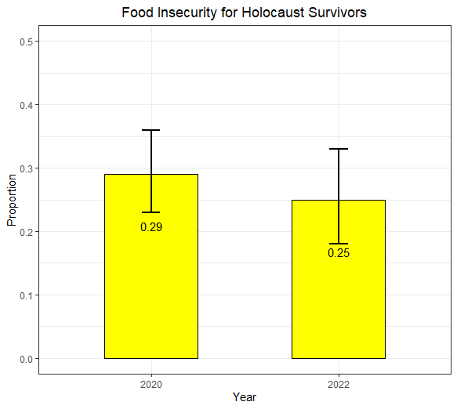
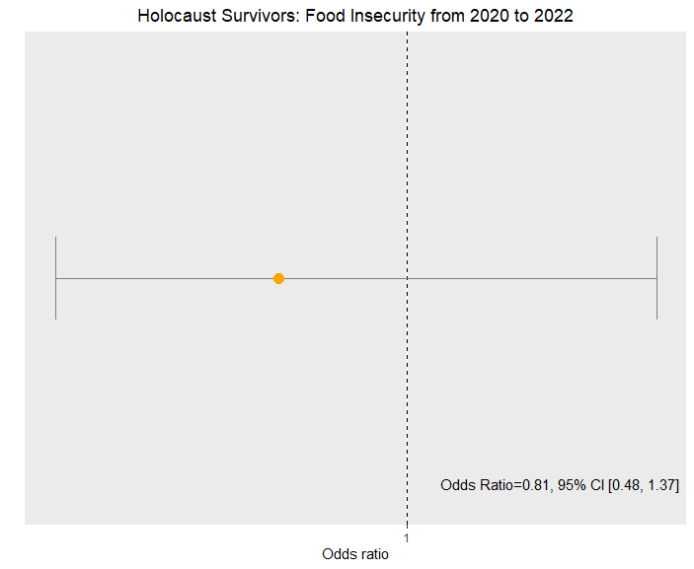
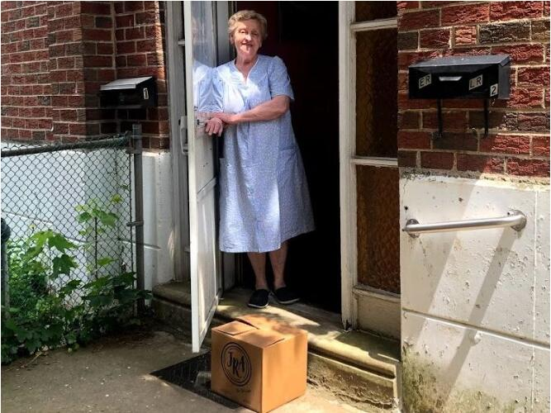
Boning Liu and Professor Laura Pyott
Department of Mathematics, West Chester University
Introduction
The JRA (Jewish Relief Agency) is an agency that provides food and toiletries boxes once per month to the people in need in Philadelphia and surrounding counties. Client satisfaction surveys were sent out to the people receiving help from the JRA.
According to the Jewish Federation of Philadelphia, there are 860 household with at least one survivors of the Holocaust. The JRA serves 347 of these households. This is a very special subpopulation of the JRA’s clients and call for extra attention, funding, and care.
This presentation focuses on comparing the degree of food insecurity (FI) among the Holocaust survivors as measured on the 2020 to 2022 surveys.
Results
In 2020, 50 clients out of 174 (29%) suffered from food insecurity, as compared to 30 clients out of 122 (25%) in 2022 a difference in percentages of 4%, p = .511. The difference from 2020 to 2022 was not found to be statistically significant. The odds ratio of food insecurity in 2020 vs 2022 is 0.81 (95% Confidence Interval: 0.48 to 1.37).
Conclusions
The percentage of Holocaust survivors that were FI had a small but not statistically significant decrease. This was good news because we would expect an increase due to the pandemic. The JRA Executive Director informed me that the agency received a lot of donations at the start of the pandemic and the JRA were able to use the fundings to provide better food boxes for the Holocaust survivors.
The JRA will report these results to their donors as a success story.
Literature cited
Hager, Erin R., et al. “Development of Validity of a Two-Item Screen to Identify Families at Risk for Food Insecurity.” Pediatrics, volume 126, number 1, July, 2010.
https:\\blog.jewishphilly.org
https:\\jewrelief.org
Materials and methods
Answers are collected from the FI related questions on the client satisfaction surveys
The responses “Often true” and “sometimes true” are assessed as positive for FI.
The FI percentages of 2020 and 2022 are then calculated and compared.
This is the FI screening question:
“Within the past 12 months, the food we bought just didn’t last and we didn’t have money to get more.”
Further information
Please see the JRA’s website https:\\jewrelief.org

